Slide 1
Live Classroom
Module 6 –Tests for Proportions and Logistic Regression

Slide 2
Topics
One Sample Tests for Proportions
Two Sample Tests for Proportions (based on risk difference)
Calculation of Effect Measures/Interpretation
Logistic Regression

Slide 3
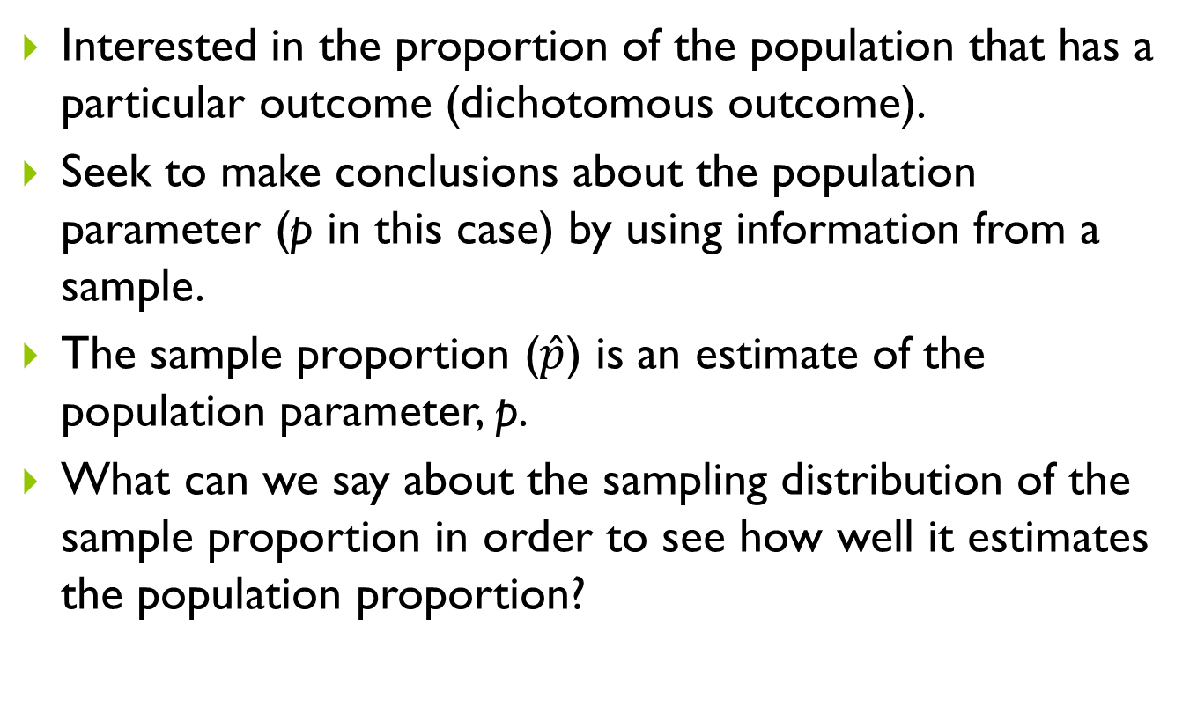
One-Sample Tests for Proportions
Interested in the proportion of the population that has a particular outcome (dichotomous outcome).
Seek to make conclusions about the population parameter (p in this case) by using information from a sample.
The sample proportion ($\hat{p}$) is an estimate of the population parameter, p.
What can we say about the sampling distribution of the sample proportion in order to see how well it estimates the population proportion?

Slide 4
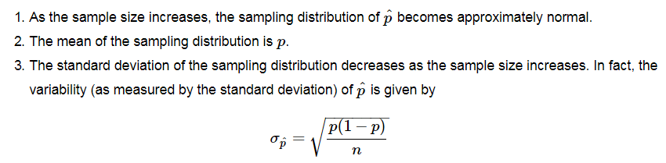
One-Sample Tests for Proportions

Slide 5

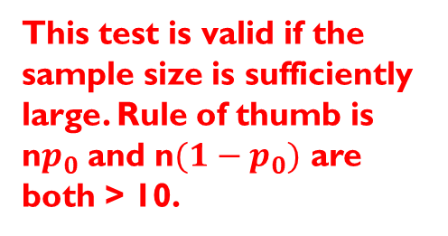
One-Sample Tests for Proportions
Tests of hypotheses about a population proportion are based on the sampling distribution of the sample proportion.
The value of the sample proportion is compared to the value of the population proportion in the null hypothesis.
If the sample proportion is far from the expected value of the population proportion under the null hypothesis, then we have evidence against the null hypothesis.
This test is valid if the sample size is sufficiently large. Rule of thumb is n$p_{0}$ and n${(1−p}_{0})$ are both > 10.

Slide 6
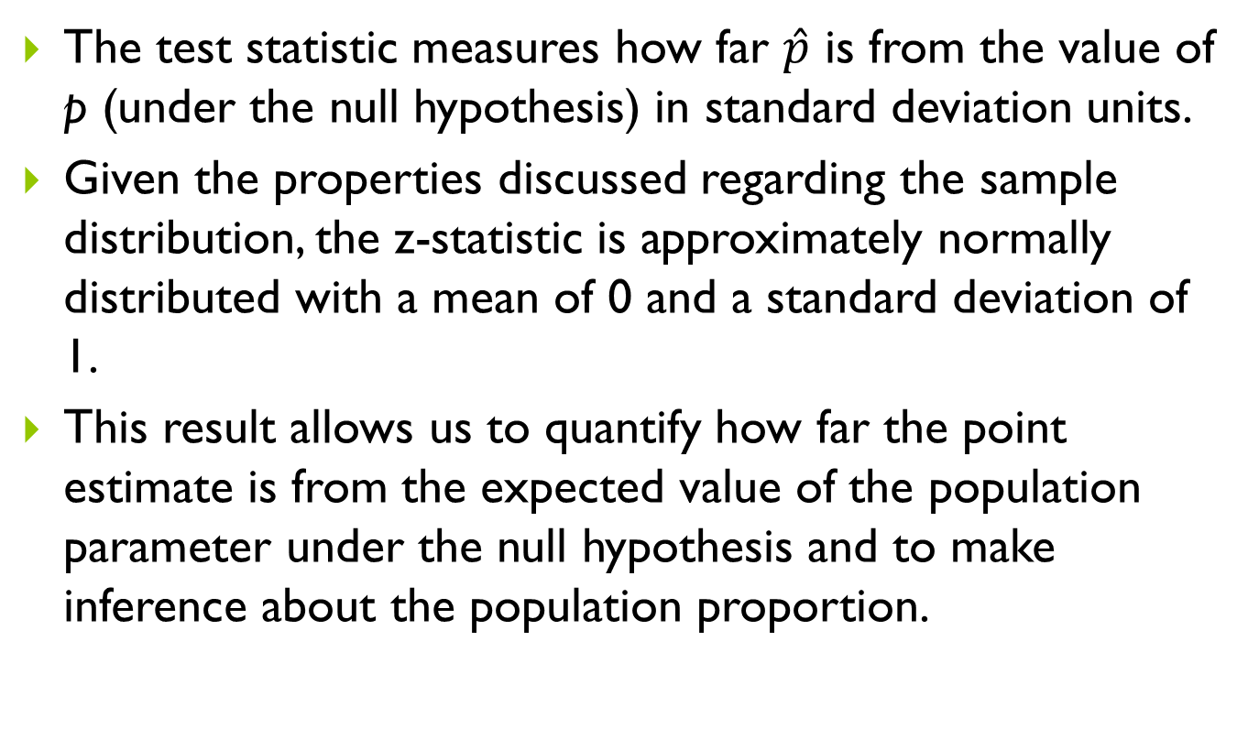
One-Sample Tests for Proportions
The test statistic measures how far $\hat{p}$ is from the value of p (under the null hypothesis) in standard deviation units.
Given the properties discussed regarding the sample distribution, the z-statistic is approximately normally distributed with a mean of 0 and a standard deviation of 1.
This result allows us to quantify how far the point estimate is from the expected value of the population parameter under the null hypothesis and to make inference about the population proportion.

Slide 7
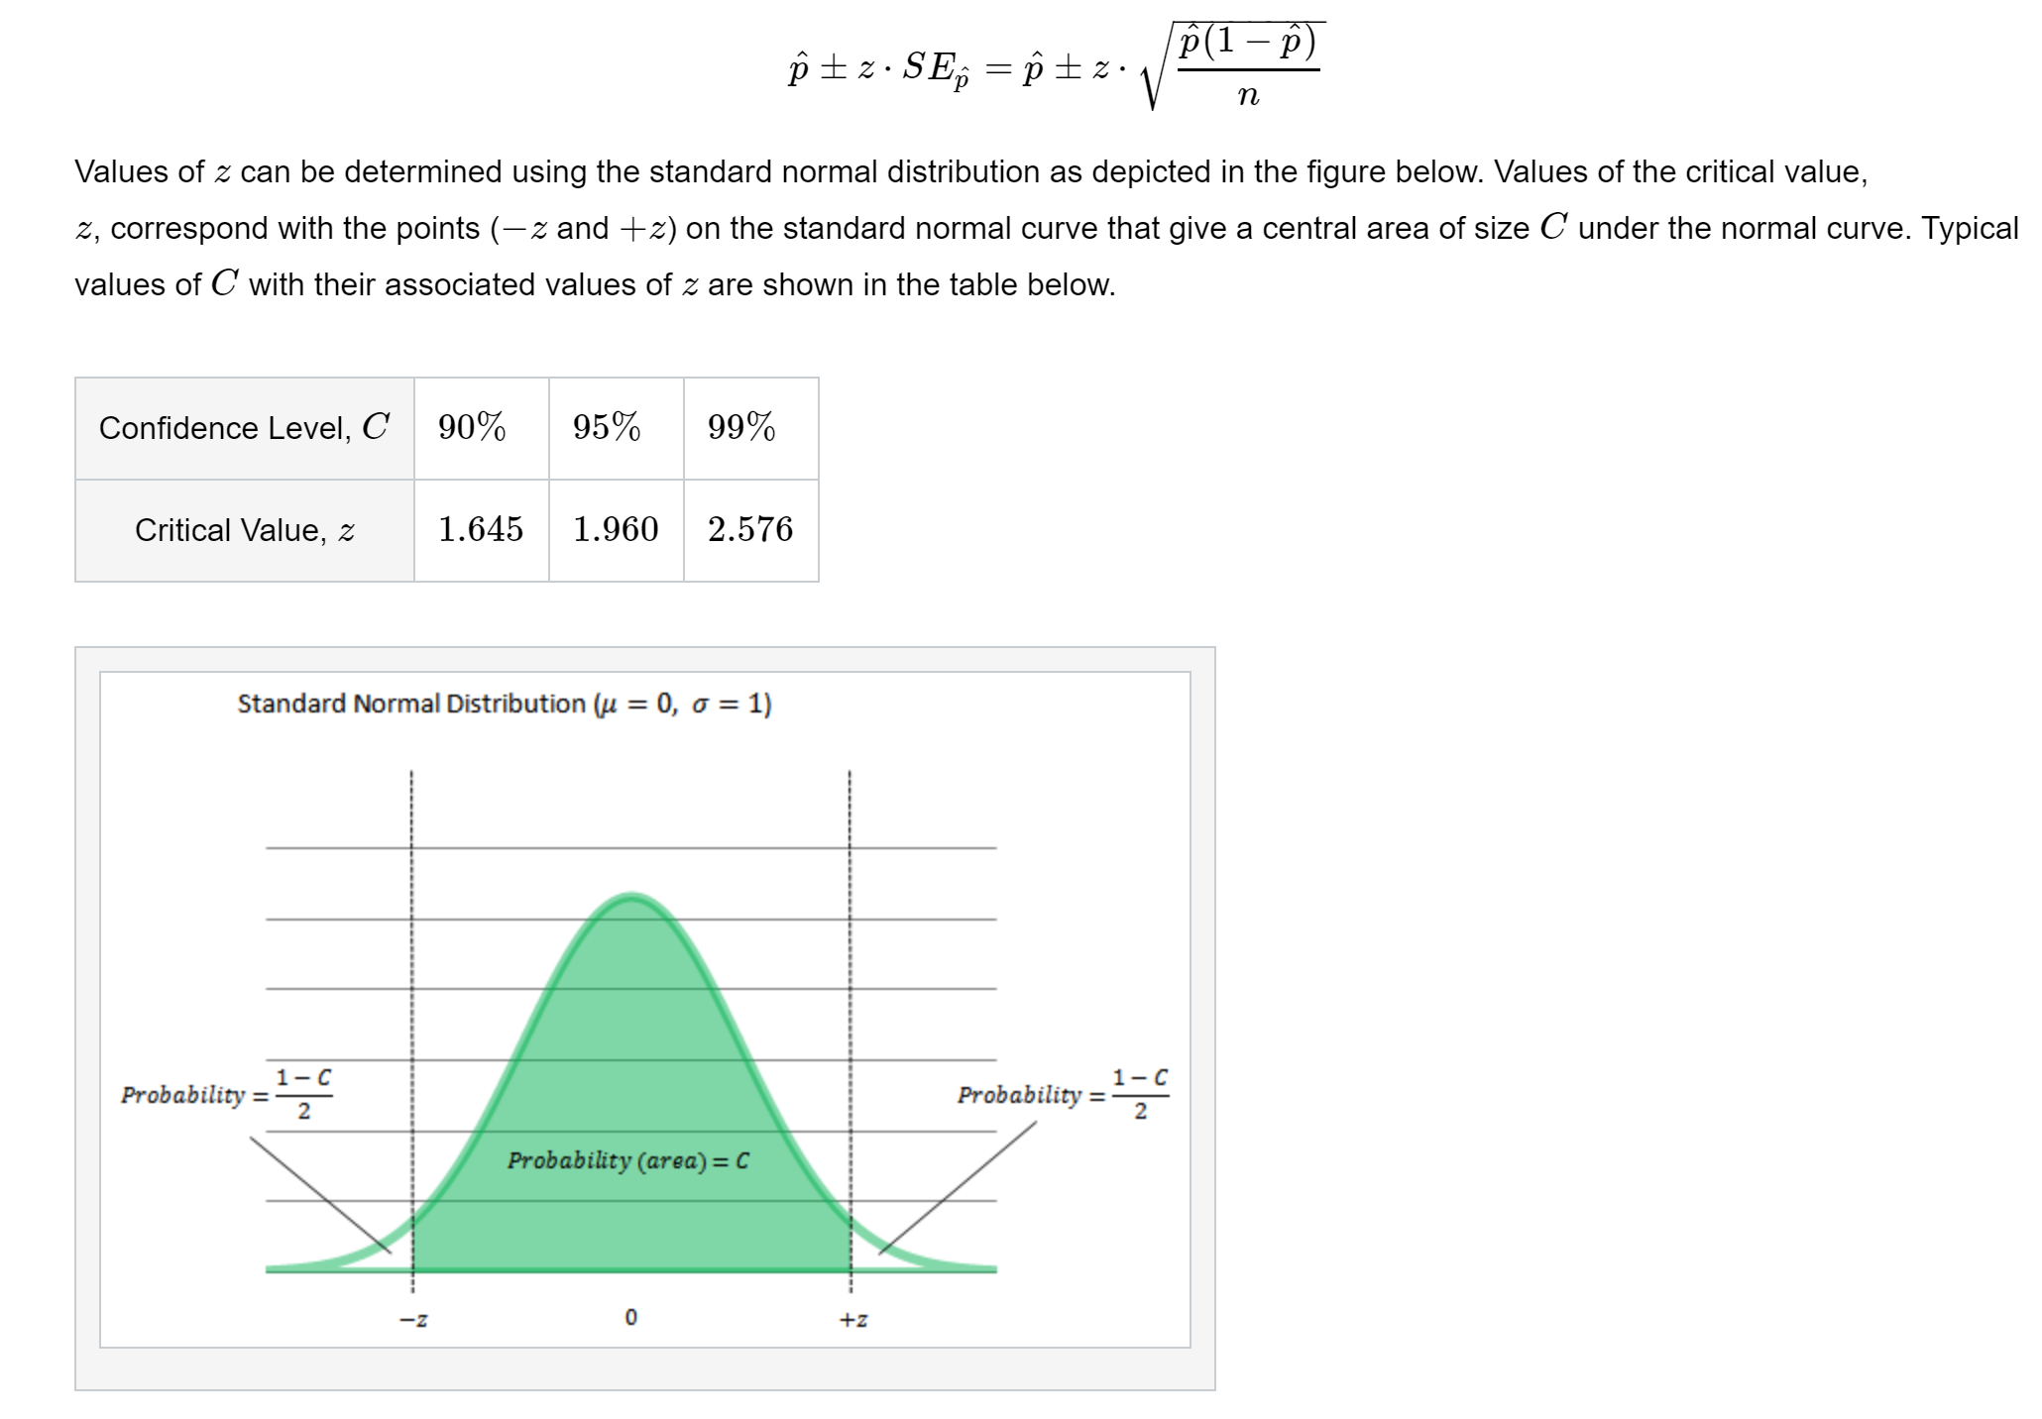
Confidence Interval for a Proportion

Slide 8
One Sample Tests for Proportions
Use the prop.test() function
prop.test([s], [n], p = [p0], alternative = [alternative], conf.level = [confidence level], correct = FALSE)
[s] = number of successes
[n] = sample size
[p0] = proportion under the null hypothesis
[alternative] = "two.sided" (default), "greater" or "less“
[confidence level] = 0.95, etc
correct = FALSE specifies not to use a continuity correction
Continuity correction is a very slight alteration of the formula for the test statistic and for the confidence interval that makes the test a little more conservative (and thus the confidence interval a little wider). May be used anytime, but is especially helpful when the sample size is small

Slide 9
Example – Vaccinations
We are interested in estimating the proportion of children in the county that are vaccinated for measles. We suspect that it may be as low as 80%. A random sample is taken of 100 children from the county. Of those sampled, only 70 were vaccinated. Formally test if the proportion of vaccinated children is different than 80%. Calculate the 95% confidence interval for the proportion of children vaccinated in the county.
prop.test(70, 100, p = 0.80,
alternative = "two.sided",
conf.level = 0.95, correct = FALSE)

Slide 10
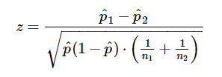

Two-Sample Tests for Proportions
Based on the null hypothesis that $p_{1}= p_{2}$ ($p_{1}−p_{2}=0)$
Check out CI formula in the notes!
Inference is valid when the counts of successes and failures are >= 5 in both samples.
Pooled sample proportion
This quantity represents how far the difference in sample proportions is from 0 in standard deviation units under the null hypothesis where the underlying population proportion is the same in the two groups.

Slide 11
Two Sample Tests for Proportions
Use the prop.test() function
prop.test([s], [n], alternative = [alternative], conf.level = [confidence level], correct = FALSE)
[s] = number of successes in each group: c(s₁,s₂)
[n] = sample size in each group: c(n₁,n₂)
[alternative] = "two.sided" (default), "greater" or "less“
[confidence level] = 0.95, etc
correct = FALSE specifies not to use a continuity correction
Continuity correction is a very slight alteration of the formula for the test statistic and for the confidence interval that makes the test a little more conservative (and thus the confidence interval a little wider). May be used anytime, but is especially helpful when the sample size is small
Calculate Risk Difference by hand

Slide 12
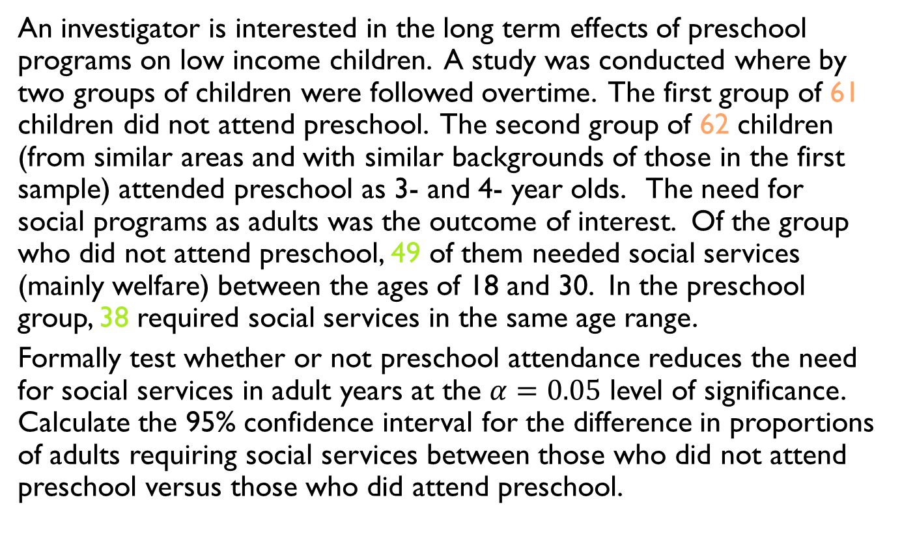
Example – Need for Social Services
An investigator is interested in the long term effects of preschool programs on low income children. A study was conducted where by two groups of children were followed overtime. The first group of 61 children did not attend preschool. The second group of 62 children (from similar areas and with similar backgrounds of those in the first sample) attended preschool as 3- and 4- year olds. The need for social programs as adults was the outcome of interest. Of the group who did not attend preschool, 49 of them needed social services (mainly welfare) between the ages of 18 and 30. In the preschool group, 38 required social services in the same age range.
Formally test whether or not preschool attendance reduces the need for social services in adult years at the $α=0.05$ level of significance. Calculate the 95% confidence interval for the difference in proportions of adults requiring social services between those who did not attend preschool versus those who did attend preschool.

Slide 13
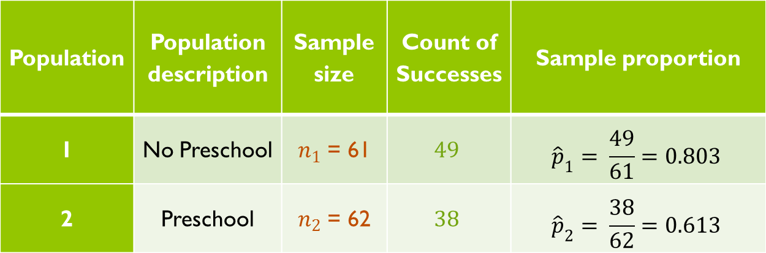
Example – Need for Social Services
prop.test(c(49,38), c(61,62), alternative = "two.sided",
conf.level = 0.95, correct = FALSE)
Risk difference = 0.19 (indicating that the need for services was higher in the group that didn’t attend preschool)
Population | Population description | Sample size | Count of Successes | Sample proportion
1 | No Preschool | $n_{1}$ = 61 | $$49$$ | $${\hat{p}}_{1}= \frac{49}{61}=0.803$$
2 | Preschool | $n_{2}$ = 62 | $$38$$ | $${\hat{p}}_{2}= \frac{38}{62}=0.613$$

Slide 14
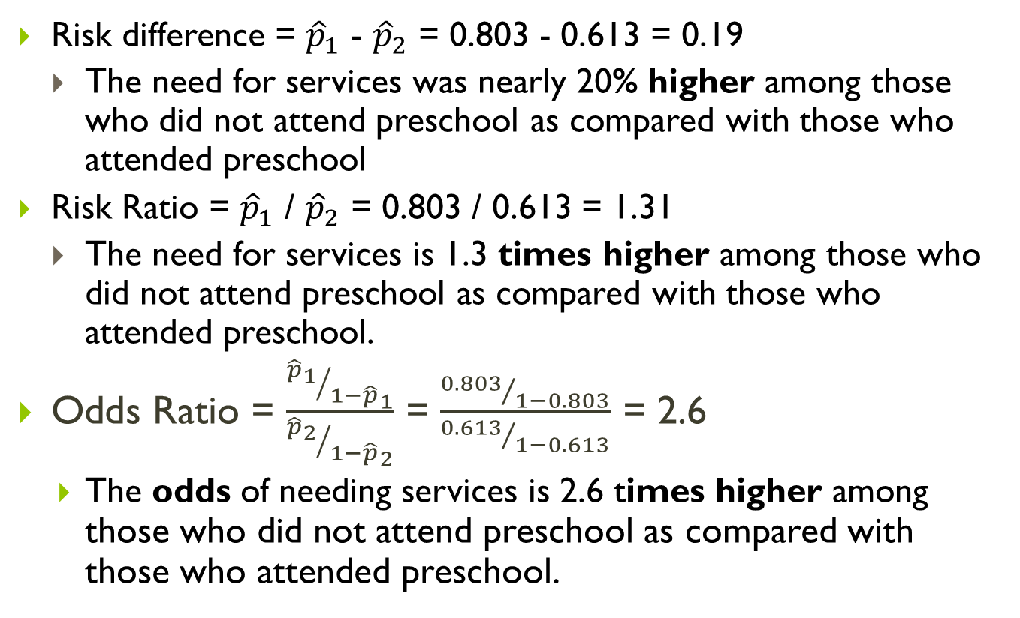
Example – Need for Social Services
Risk difference = ${\hat{p}}_{1}$ - ${\hat{p}}_{2}$ = 0.803 - 0.613 = 0.19
The need for services was nearly 20% higher among those who did not attend preschool as compared with those who attended preschool
Risk Ratio = ${\hat{p}}_{1}$ / ${\hat{p}}_{2}$ = 0.803 / 0.613 = 1.31
The need for services is 1.3 times higher among those who did not attend preschool as compared with those who attended preschool.
Odds Ratio = $\frac{{{\hat{p}}_{1}}/{1−{\hat{p}}_{1}}}{{{\hat{p}}_{2}}/{{1−\hat{p}}_{2}}}$ = $\frac{{0.803}/{1−0.803}}{{0.613}/{1−0.613}}$ = 2.6
The odds of needing services is 2.6 times higher among those who did not attend preschool as compared with those who attended preschool.

Slide 15
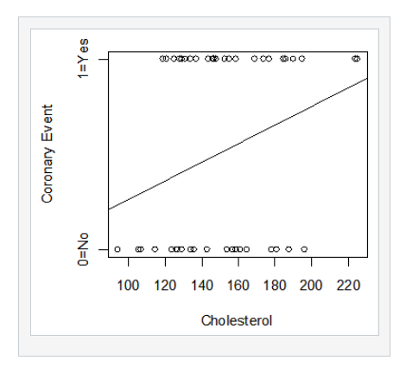
Logistic Regression

Slide 16
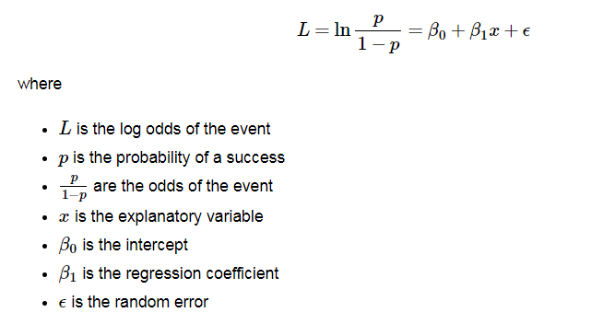
Logistic Regression

Slide 17

Logistic Regression
We can predict the risk of the outcome of interest, using the estimates of the slope and intercept.

Slide 18



Logistic Regression
The interpretation of the regression coefficients are generally based on odds ratios. Consider the odds ratio for an event given x=A vs. x=B.

Slide 19
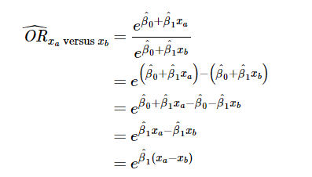
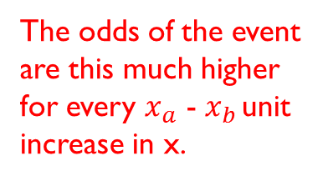
Logistic Regression
The interpretation of the regression coefficients are generally based on odds ratios. Consider the odds ratio for an event given x=A vs. x=B.
The odds of the event are this much higher for every $x_{a}$ - $x_{b }$unit increase in x.
Check out section in notes on confidence intervals for the OR!

Slide 20
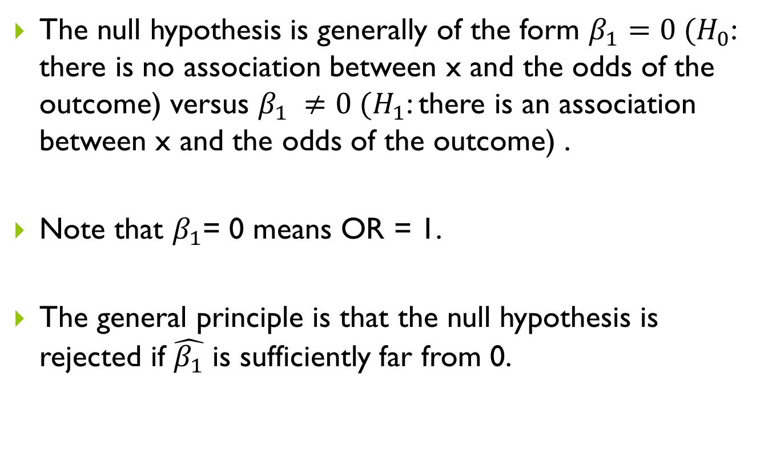
Logistic Regression
The null hypothesis is generally of the form $β_{1}=0 (H_{0}$: there is no association between x and the odds of the outcome) versus $β_{1} ≠0 (H_{1}$: there is an association between x and the odds of the outcome) .
Note that $β_{1}$= 0 means OR = 1.
The general principle is that the null hypothesis is rejected if $\hat{β_{1}}$ is sufficiently far from 0.

Slide 21
Logistic Regression
Use the glm() function with binomial option
glm(data$event ~ data$explanatory1 + data$explanatory2 + … , family = binomial)
Ensure that your event is coded 1 = Event and 0 = Non Event (numeric, as opposed to a factor variable)
If one of the variables in the model is a factor variable, it is best to create dummy variables (1/0) so that you know exactly what the reference group is
Use the summary() function on saved regression result to get regression equation and associated tests for each regression coefficient
Use the exp() function on the resulting coefficients to obtain odds ratios for each regression coefficient
Use the predict() function on the saved regression result to get the predicted risks for each observation (or calculate manually)
In multiple logistic regression, use the wald.test() function (from “aod” package) to get p-value for the global test (of all beta coefficients = 0)
Use the roc() function (from the “pROC” package) to get c-statistic (area under the curve) and to generate the ROC curve

Slide 22
Example – Risk of a Coronary Event
Suppose we are interested in the association between cholesterol levels, age and gender on having a coronary event in a high risk patient population (who have had an event in the past). We collect information on these parameters for 50 subjects and then follow each for a year to see if they have another coronary event.

Slide 23
Example – Risk of a Coronary Event
Simple logistic Regression (predicting risk from cholesterol only)
Odds Ratios and confidence intervals (1 and 10 unit increase)
Risk prediction
Multiple logistic Regression (predicting risk from age, gender and cholesterol)
Global test and individual tests

Slide 24
Area under the ROC Curve
In linear regression, the R squared value was helpful in quantifying the proportion of variability in the outcome explained by the regression model.
We need to use the predicted values in the logistic regression setting.
Sensitivity: Proportion of true events classified correctly.
Specificity: Proportion of true non-events classified correctly.
Area under the ROC (receiver operating characteristic) curve (also known as the c-statistic) is a measure of the sensitivity and specificity across a range of possible cutoffs.
Often measures GOF for logistic model.

